Slide 1
SOC Design
Lab4-1 Excute Code in User Memory
https://docs.google.com/presentation/d/1AthhqlIutsZ43j4bx8yGtALSd0lrbU91ZgXG7jO7w34/edit?usp=sharing
Introduce UART, Interrupt, User BRAM by Willy, Josh

Slide 2
Content
Prepare firmware code & RTL
FIR in C code
Firmware management in main()
Linker for address arrangement
Design your BRAM in user_project
Compilation
Synthesis & Verification
Reference
https://github.com/bol-edu/caravel-soc_fpga-lab/tree/main/lab-exmem_fir

Slide 3
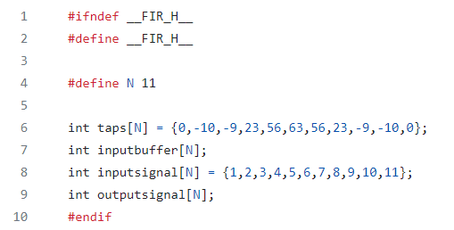
FIR in C code
Generate data in header file
In lab-exmem_fir/testbench/fir.h
Defined by yourself

Slide 4
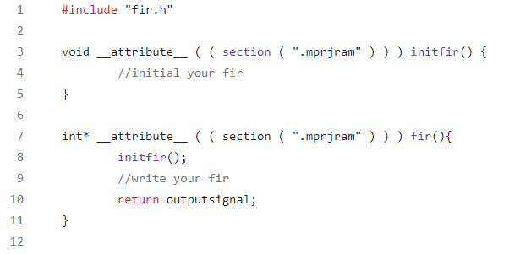
FIR in C code
In lab-exmem_fir/testbench/fir.c
The function is located at section “mprjram”. Don’t modify it.

Slide 5
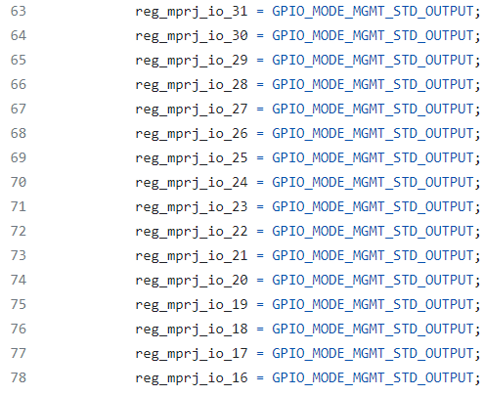
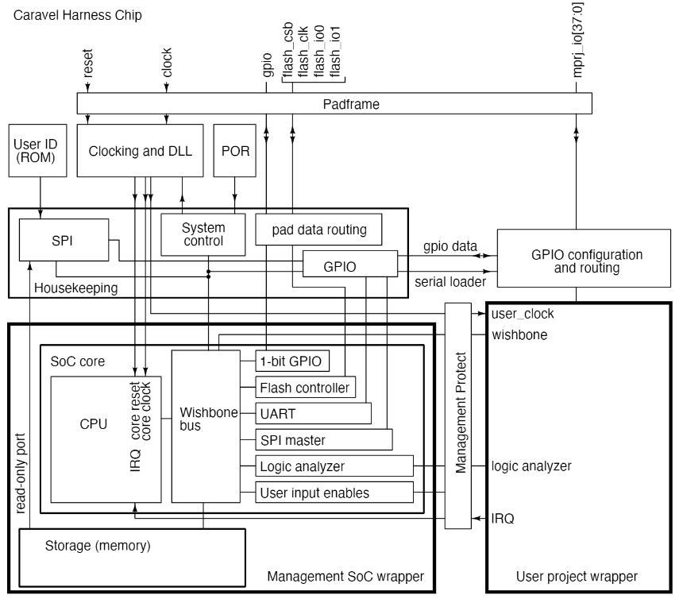

Firmware management in main()
Setting IO pad. CPU will keep idle until reg_mprj_xfer = 0
In lab-exmem_fir/testbench/counter_la_fir.c

Slide 6
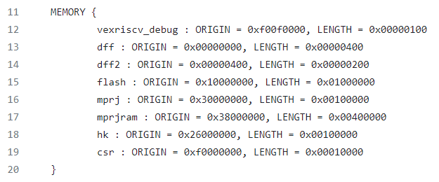
Linker for address arrangement
In lab-exmem_fir/firmware/section.lds
Allocate 4MB memory for mapping but notice that the size of BRAM in user_project is limited

Slide 7
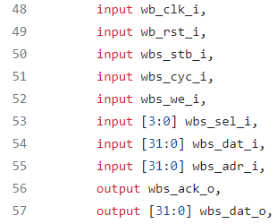
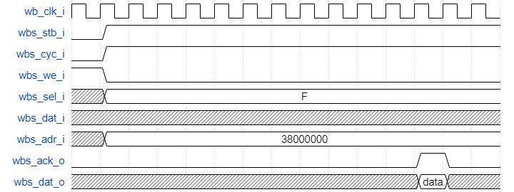
Design your BRAM in user_project
In lab-exmem_fir/rtl/user_proj_example.counter.v
Design the controller connected with wishbone bus
Response after the parameter Delay
Delay = 10
Read BRAM

Slide 8
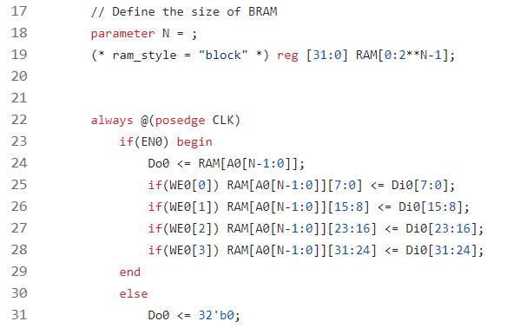
Design your BRAM in user_project
In lab-exmem_fir/rtl/bram.v
Estimate the required size of BRAM

Slide 9
Compilation
Given script to compile
.
Transform .elf to .hex
.
Export assembly code for debugging
.
riscv32-unknown-elf-gcc -I../../firmware -o counter_la_fir.elf ..
riscv32-unknown-elf-objcopy -O verilog counter_la_fir.elf counter_la_fir.hex
riscv32-unknown-elf-objdump -D counter_la_fir.elf > counter_la_fir.out

Slide 10
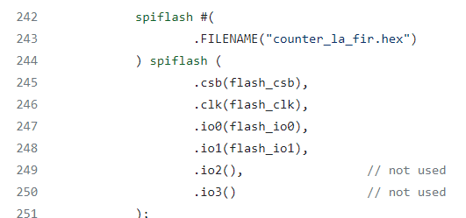
Compilation
Simulate by xsim after compiling C code
Note that .hex is directly written on testbench

Slide 11
In this Lab you need to …
Write FIR C code
fir.c
fir.h
Write RTL in user_project
Controller for delayed response and communication between BRAM and wishbone bus (wishbone timing -> SRAM timing)
Define suitable size of BRAM

Slide 12
Submission Guideline
SOC Design

Slide 13
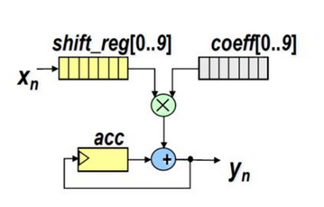
Design of the lab
You are required to apply the design of lab3.
Add Wishbone (WB) interface to communicate with RISCV.
All the input data (coef and x[n]) are listed in and coef.dat samples_triangular_wave.dat

Slide 14
RISCV-FIR Handshake Specification
RISCV Program coeff memory by WB.
RISCV WB write x[n] input.
(note: you should make sure FIR is ready accept the data)
RISCV check if y[n] is ready, if yes: read y[n], otherwise wait.
(note: you need to have flag to indicate y[n] is ready)
When finish, write final Y (lower 16-bit) through mprj pin.
Testbench check correctness, use one mprj pin to indicate the output result is ready.
(note: initially, the ready pin should be deasserted)
Golden data is listed in out_gold.dat

Slide 15
Submission (1/2)
Hierarchy:
StudentID_lab4/
Report.pdf
Github link
Your Github link should attach the file:
Design
WB interface
RISC-V
Report

Slide 16
What is included in the report
The programming interface between RISCV and user project.
What is the throughput?
Suggest performance improvement based on the observation.
e.g. Speed up the FIR processing speed
Reduce the RISCV overhead in moving data.
e.g. enlarge Shift_RAM size = 12 DW (one more than TapeRAM size) – what is the effect ?

Slide 17
Submission (2/2)
Compress all above files in a single zip file named
StudentID_lab4.zip (e.g., 111061545_lab4.zip)
Submit to HKUST Canvas
Deadline:
‐ 20% off for the late submission penalty within 3 days

